Slide 1
Slides for HDFC Ergo

Slide 2
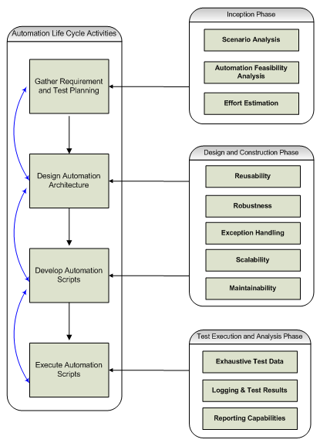
Automation Approach

Slide 3
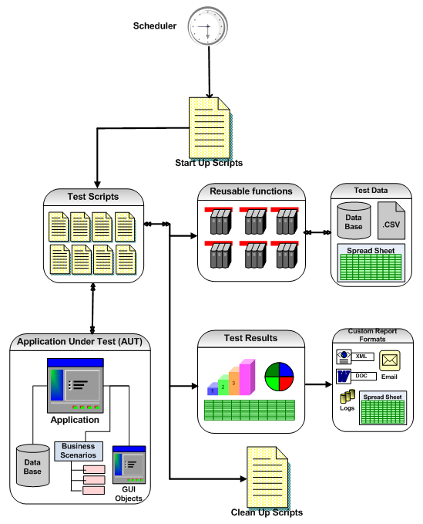
Our Automation Framework
Our test approach framework addresses traditional automation challenges by focusing on Reusability, Maintainability and enhancing efficiency in test automation

Slide 4

Key components of Planit Test Automation Strategy
Methodology
Process
Frameworks
ROI Analysis
People skills
Project Mgmt

Slide 5
ROI Analysis

Slide 6
Best Practices
Our expertise is to give best automation solution based on the past experiences and current testing needs of client.
Frameworks are designed using open source technologies which makes it cost effective and yet powerful to fulfil automation requirements.
Team has rich experience in scenario development which helps client in choosing right set of scenarios as a automation candidate.
Best track record on giving quick ROI through providing detailed analysis after every execution cycle which helps stakeholders to make quick and right decisions on the build deployment.
Team is well versed with agile approach so it will help in giving right deliverable at every sprint.
Continuous feedback from stakeholders at every milestone to make whole automation solution updated also makes it best fit in the whole development cycle.
Our approach is to make value addition in project life cycle by providing risk based testing approach to minimize the turn around time of executions with maximum coverage to critical functionalities of the application.

